Slide 1

DATABASES AND APPLICATIONS
SUBJECT CODE : UQ23CA653A
Samyukta D Kumta
Computer Applications

Slide 2
DATABASES AND APPLICATIONS
UNIT-IV- JDBC
A real life application needs to manipulate data stored in a Database.
A database is a collection of related data in the form of Tables. Most of the database uses SQL (Structured Query Language) to Insert, Delete, Update or retrieve stored data.
In order to connect a Java application to a database designed in MySQL, Oracle, Sybase, MS SQL Server etc, you need a Bridge/Interface Driver Program.
Java Provides JDBC (Java Database Connection)

Slide 3
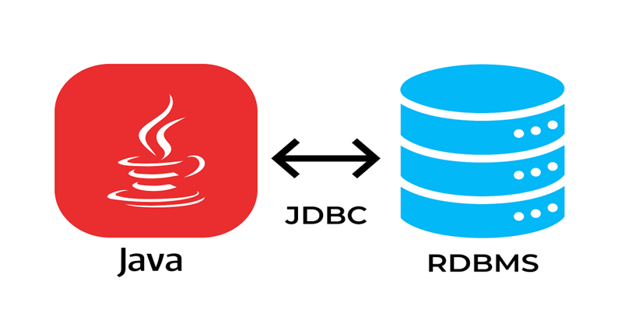
DATABASES AND APPLICATIONS
UNIT-IV- JDBC
JDBC is JAVA’s Database connection driver interface which performs the following task for the application.
Establish a connection with a Database.
Send SQL request (Query) to a Database Server.
Returns Result obtained against Query.

Slide 4
DATABASES AND APPLICATIONS
UNIT-IV- JDBC
Why JDBC should be used?
It allows the java programs to interact with multiple DBMS using the same API, so you don't have to write to separate code for each DBMS.
JDBC make it easy to develop java programs that can access and manipulate data stored in database management system.

Slide 5
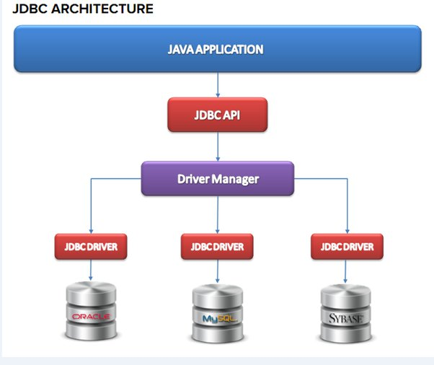
DATABASES AND APPLICATIONS
UNIT-IV- JDBC

Slide 6
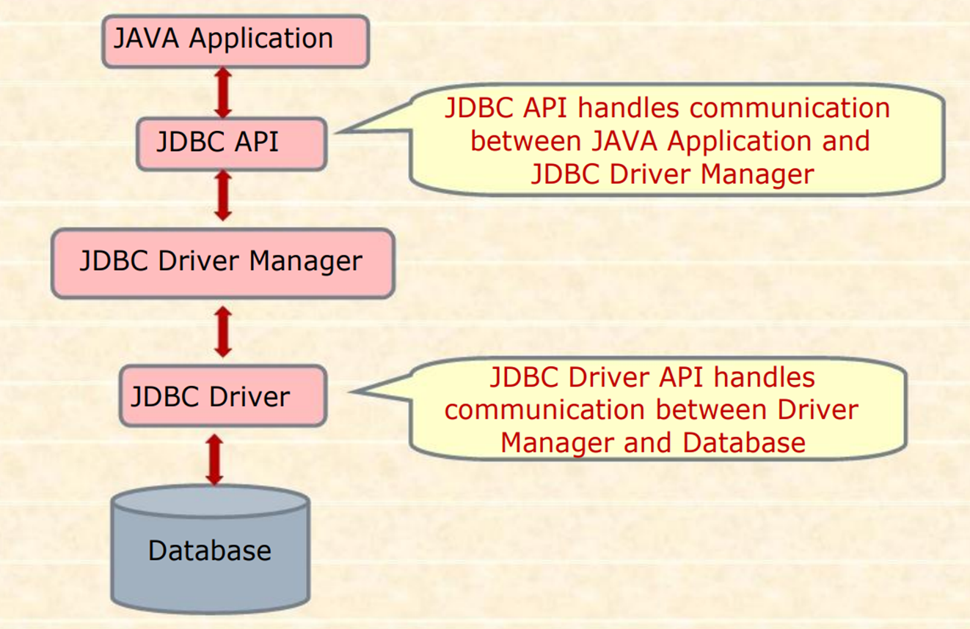
DATABASES AND APPLICATIONS
UNIT-IV- JDBC

Slide 7
DATABASES AND APPLICATIONS
UNIT-IV- JDBC
The Core element of JDBC is JDBC API, which consists of a set of Java classes equipped with predefined methods to handle various data access functions such as Selecting appropriate database driver, establishing connection, submitting SQL query and processing results.
JDBC API offers four main classes, which are-
DriverManager Class: It loads the JDBC driver to locate, logs and access a database.
Connection Class: It manages communication between Java Client Application and Database, through SQL statements.
Statement Class: It contains SQL commands which is submitted to the Database Server and returns ResultSet object containing the result of SQL statement.
ResultSet Class: It provides predefined methods to access and convert data values returned by the executed SQL statement.

Slide 8
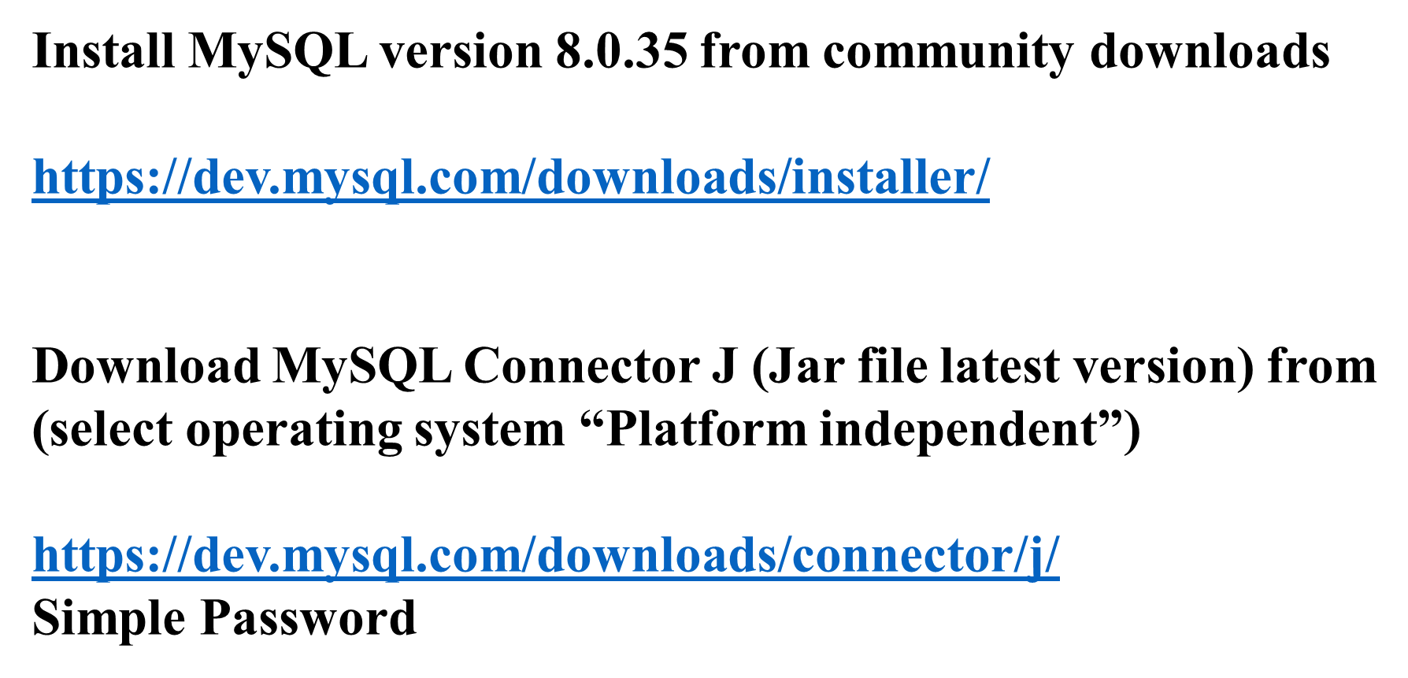
DATABASES AND APPLICATIONS
UNIT-IV- JDBC

Slide 9
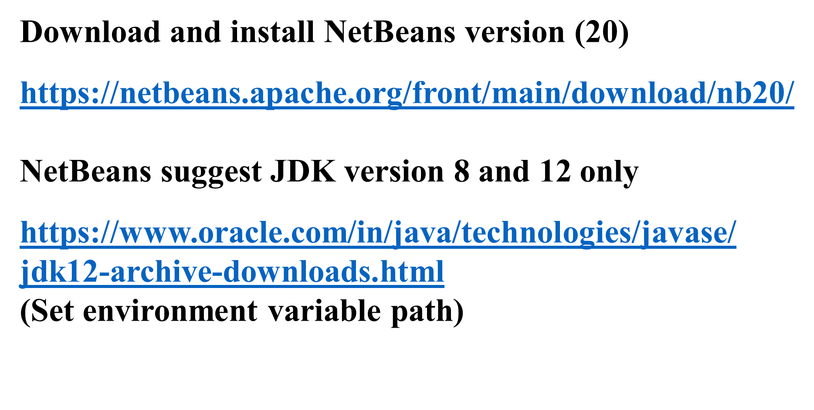
DATABASES AND APPLICATIONS
UNIT-IV- JDBC

Slide 10

THANK YOU
Samyukta D Kumta
Department of Computer Applications
samyuktad@pes.edu

